Slide 1
Employee Attrition
Greg Norman
Isaac Winters
Siwoo Lee
Robert Danielson

Slide 2
Problem
Current Attrition Rate is over 15% per year
Attrition Costs:
  Projects Fall Behind
  Recruiting Costs
  Training New Hires
What factors go into the high attrition rate?
Predicting who is likely to leave.
https://www.kaggle.com/vjchoudhary7/hr-analytics-case-study#general_data.csv

Slide 3
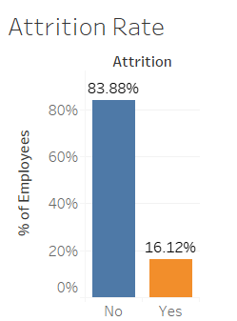
Exploratory Analysis
Import CSV using Pandas
  Merged three datasets using SQL
Exploratory Analysis using:
  MatPlotLib
  Seaborn
  Tableau
Convert to fields to numeric using get_dummies

Slide 4
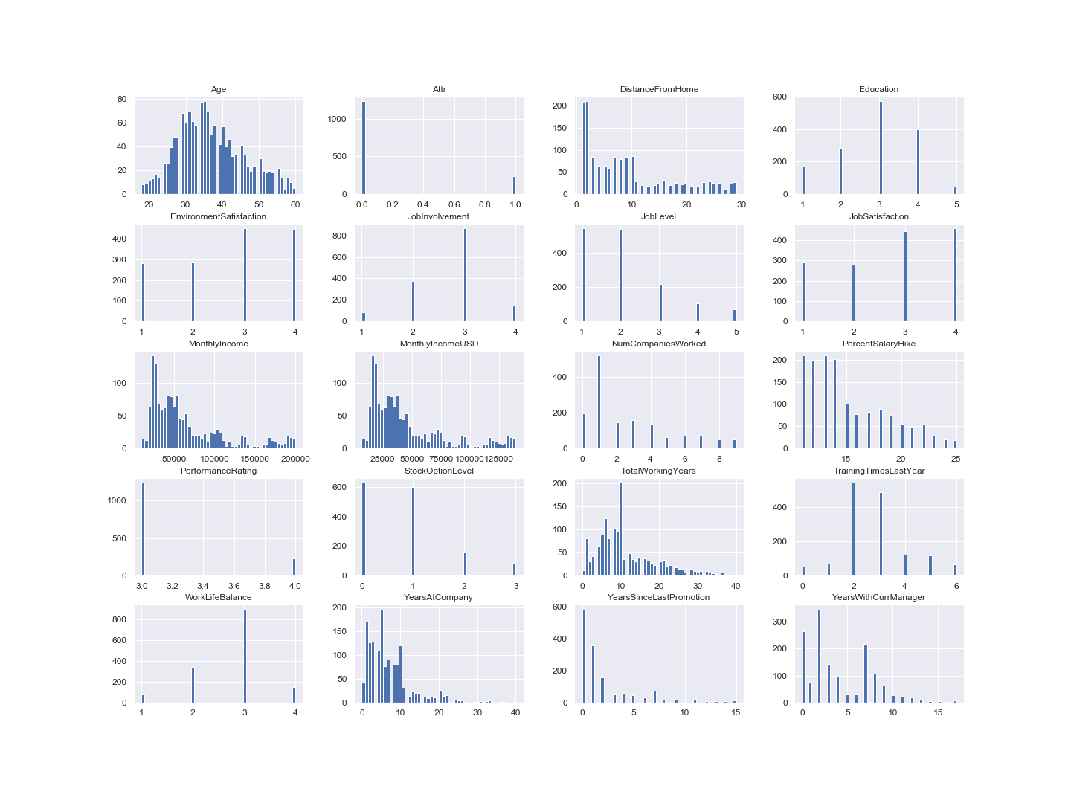
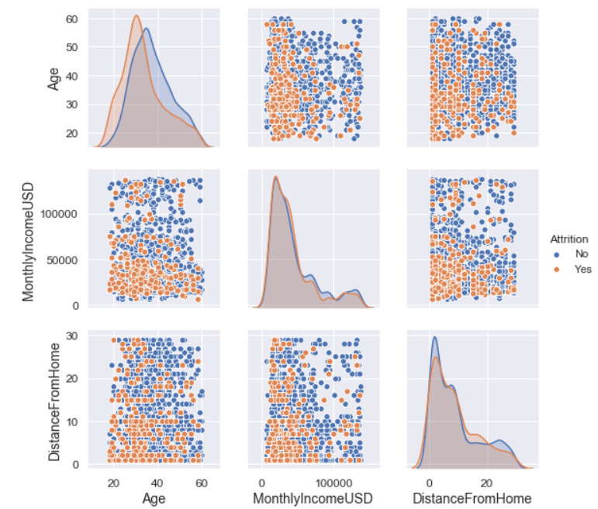
Matplotlib and Seaborn Research
Notes:
From Matplotlib mention Performance Ratings were noted at only at 3 and 4, no 1 or 2.
Smallest salary hike is 11% largest was 25%
For Seaborn mention that younger people tend to leave the company more often.

Slide 5
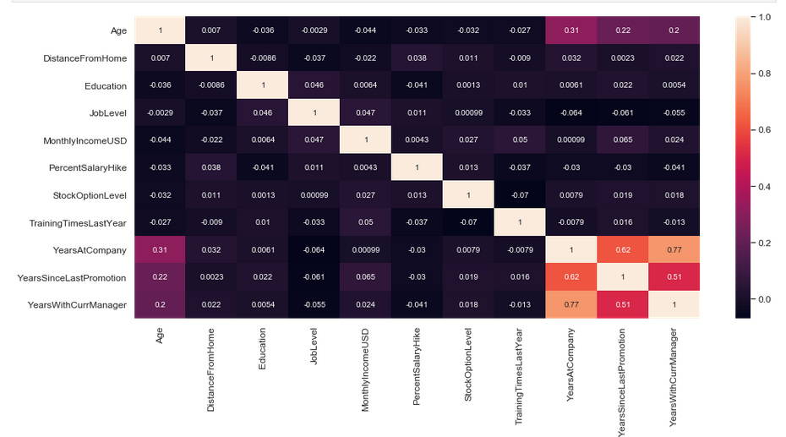
Correlation Matrix

Slide 6
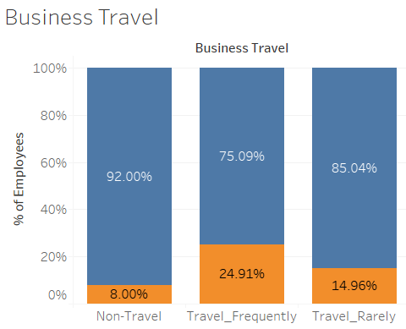
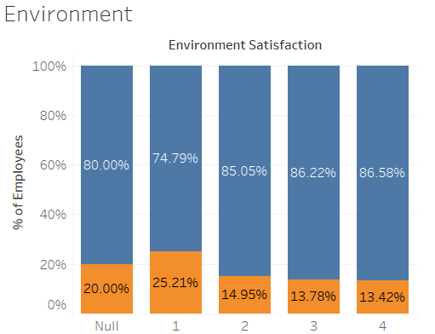
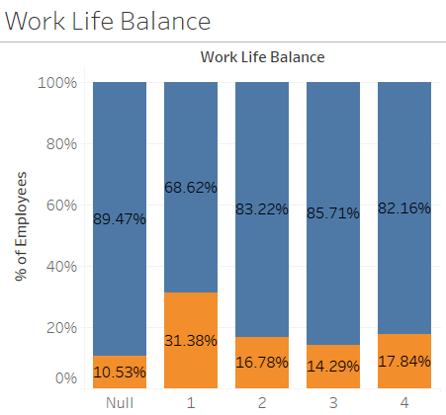
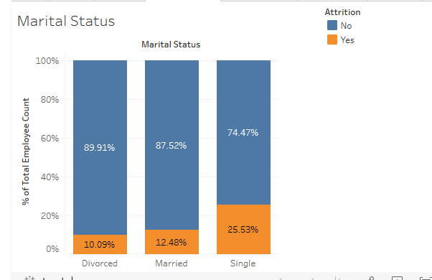
Tableau Research
Notes:
People that travel frequently are 10% more likely to leave the company
Environmental satisfaction matters, employees 10% more likely to leave the company
Employees with a poor a work life balance are 13% more likely to leave the company
The longest-term employees are on the lower end of the pay spectrum.

Slide 7
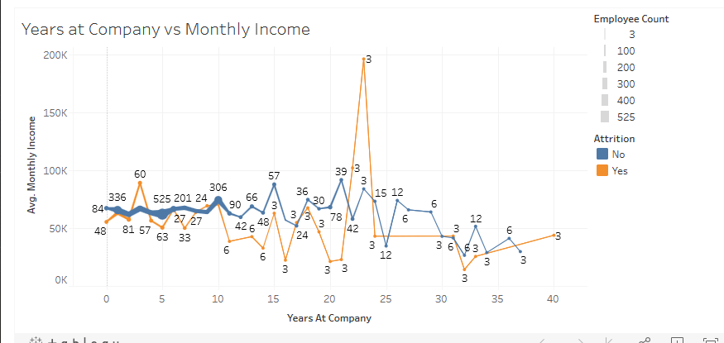
Monthly Income

Slide 8
Major Exploratory Findings
Tripled records, possibly to increase the size of the data set
Not all Employees Completed Employee Survey
Classification Problem:
  Logistic Regression
  Random Forest
  Neural Network

Slide 9
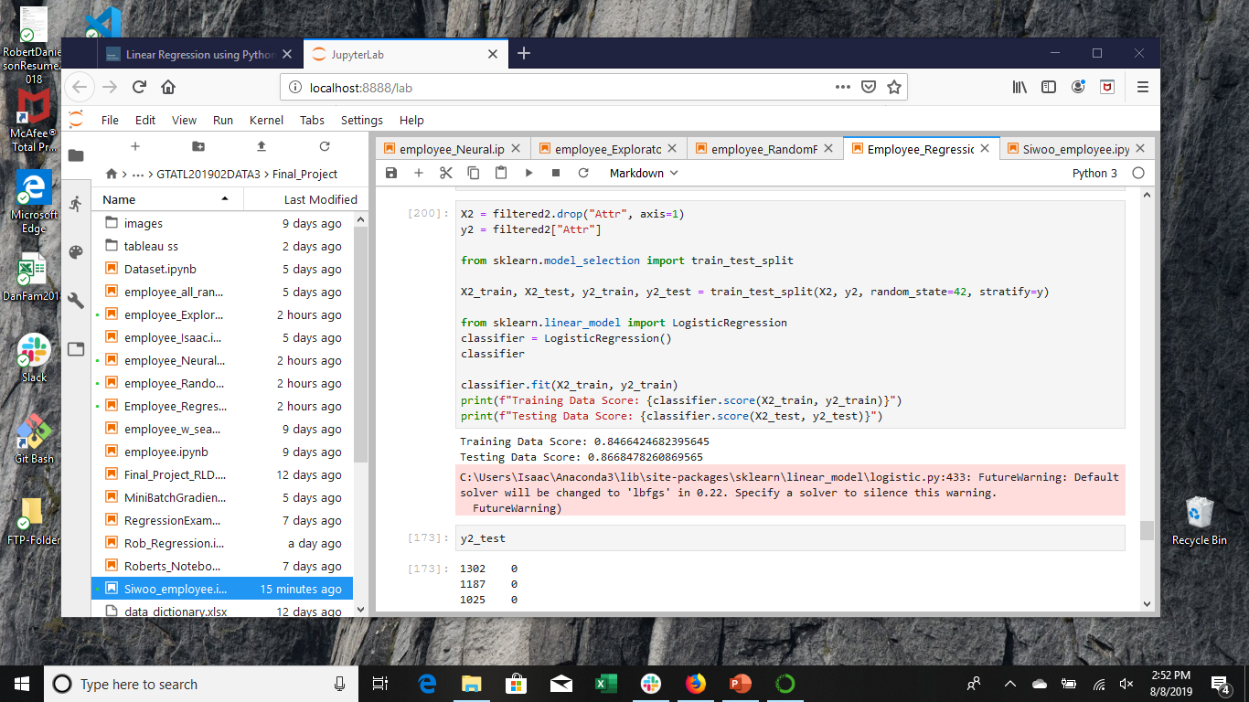
Logistic Regression Model
Use one feature – Accuracy – 0.838
Number of Companies Worked For, Total Working Years, Years with Current Manager, Years at Company, Environmental Satisfaction, Job Satisfaction, Work Balance Accuracy – 0.845
Marital Status_Single, Business Travel_Non Travel, Business Travel_Frequently
All features Accuracy – 0.866

Slide 10
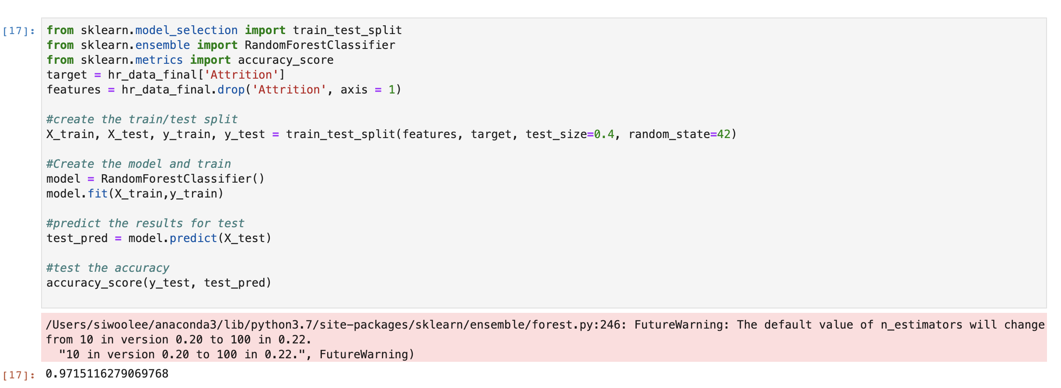
Random Forest Model
Random Forest Classification
Provides the importance of variables/features

Slide 11
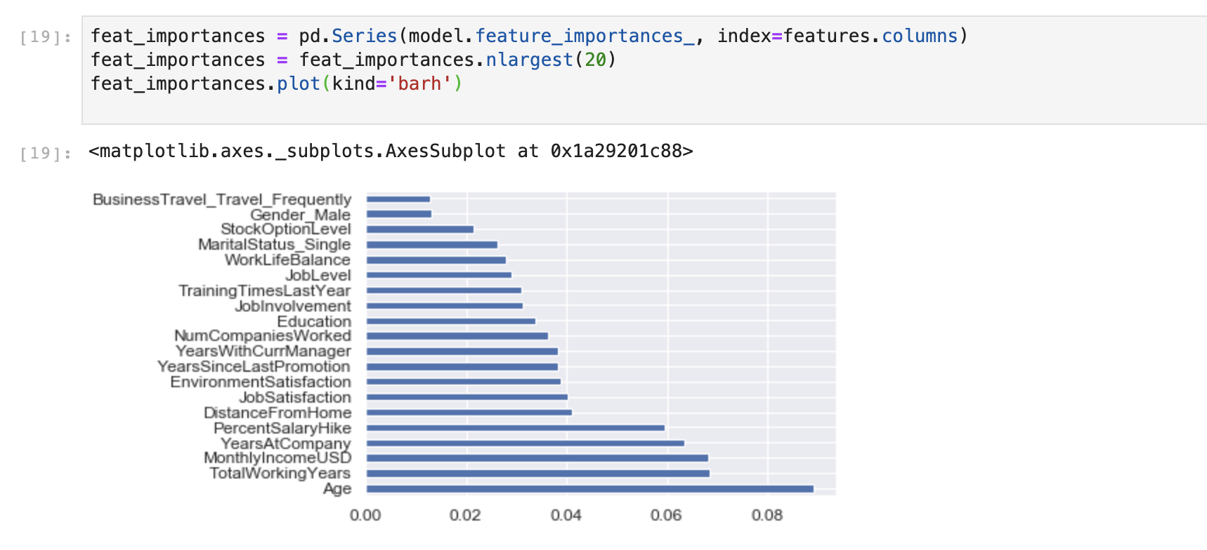
Feature Importance

Slide 12
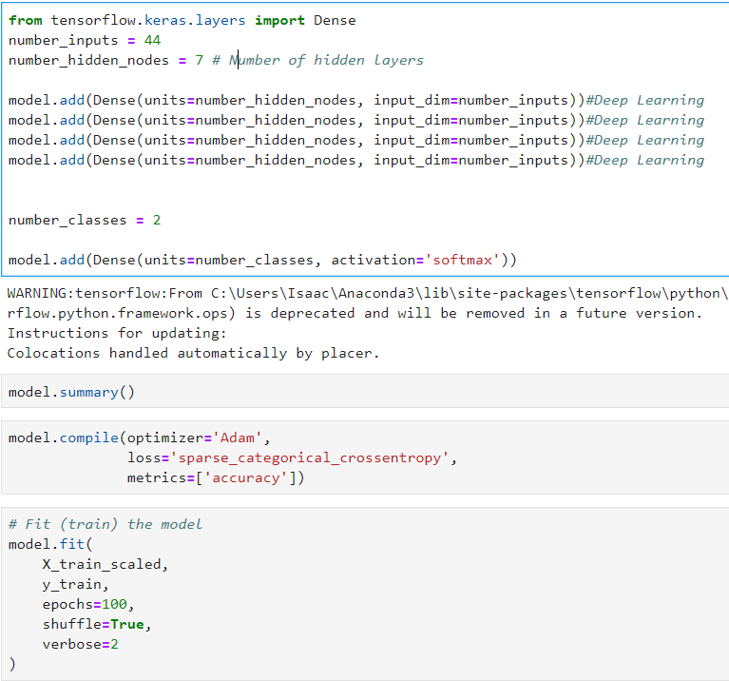
Neural Network Model
Full Sample Accuracy - 0.849
Partial Sample Accuracy - 0.872
44 Inputs, 7 Nodes, 4 Deep Learning Layers

Slide 13
Conclusions
Random Forest - Age, Monthly Income, Total Working Years and Years at Company features are high indicators of Attrition
  Accuracy 0.97
Logistic Regression Accuracy 0.84
Neural Network Accuracy 0.87

Slide 14
Questions?

